Slide 1
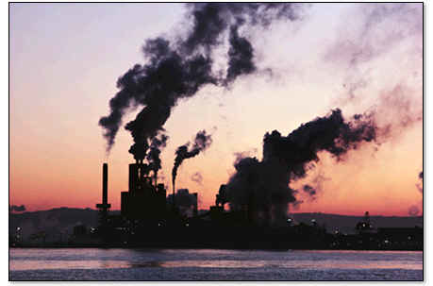
Greenhouse Gas Emissions
Lexington, KY & Fayette County, KY

Slide 2
Lexington GHG Emissions
Fayette County generates about 6, 523,469 MT of C02 Annually
Takes into account emissions from businesses, industry, waste and transportation, residences and large institutions
Estimated about 23.4MT of CO2 per person per year in city of Lexington

Slide 4
Fayette County Emissions by Sector
Residential: 1,850,553—28.4%
Commercial: 2,305,877—35.3%
Industrial: 653,380—10%
Waste and Waste Transportation: 192,422—2.9%
Note: Residential Sector uses the most electricity

Slide 5
University of Kentucky
Service: Secondary Education
123,719 MT Carbon Dioxide Emissions Annually

Slide 6
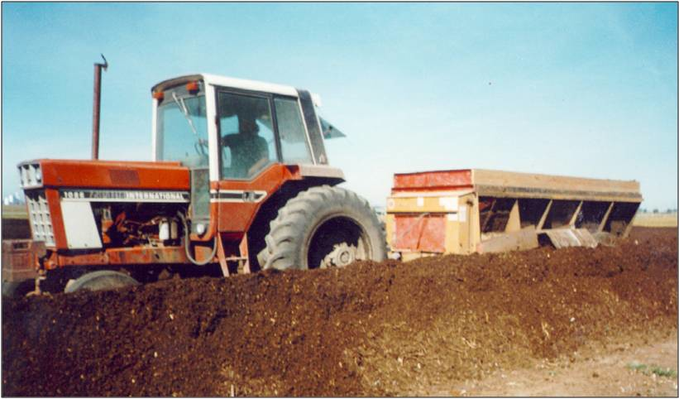
Lexington Landfill
Service: Municipal Waste depository for the city of Lexington and surrounding area
166,341 MT of Carbon Dioxide Emitted Annually

Slide 7
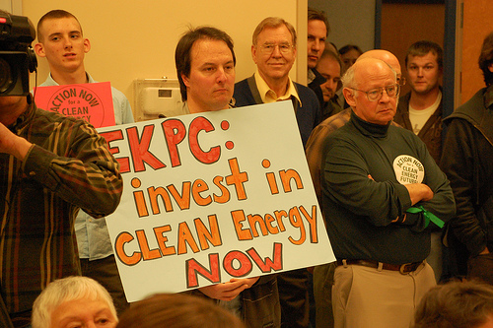
Smith Generating Facility
Service: Coal-fired power plant, provides energy for surrounding area
302,777 MT of Carbon Dioxide emitted annually

Slide 8
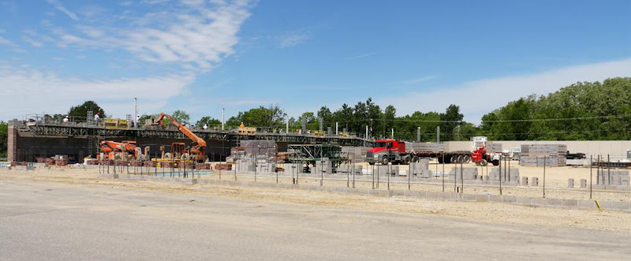
Osram Sylvania
Service: Industrial glass production
37,808 MT of Carbon Dioxide Emitted Anually

Slide 9
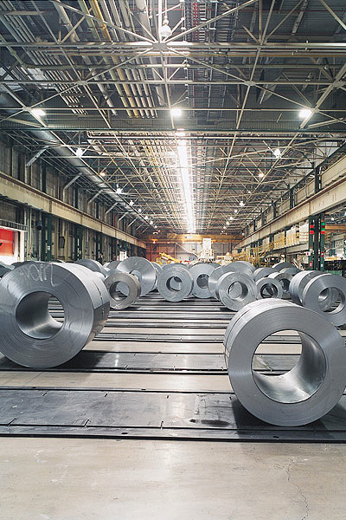
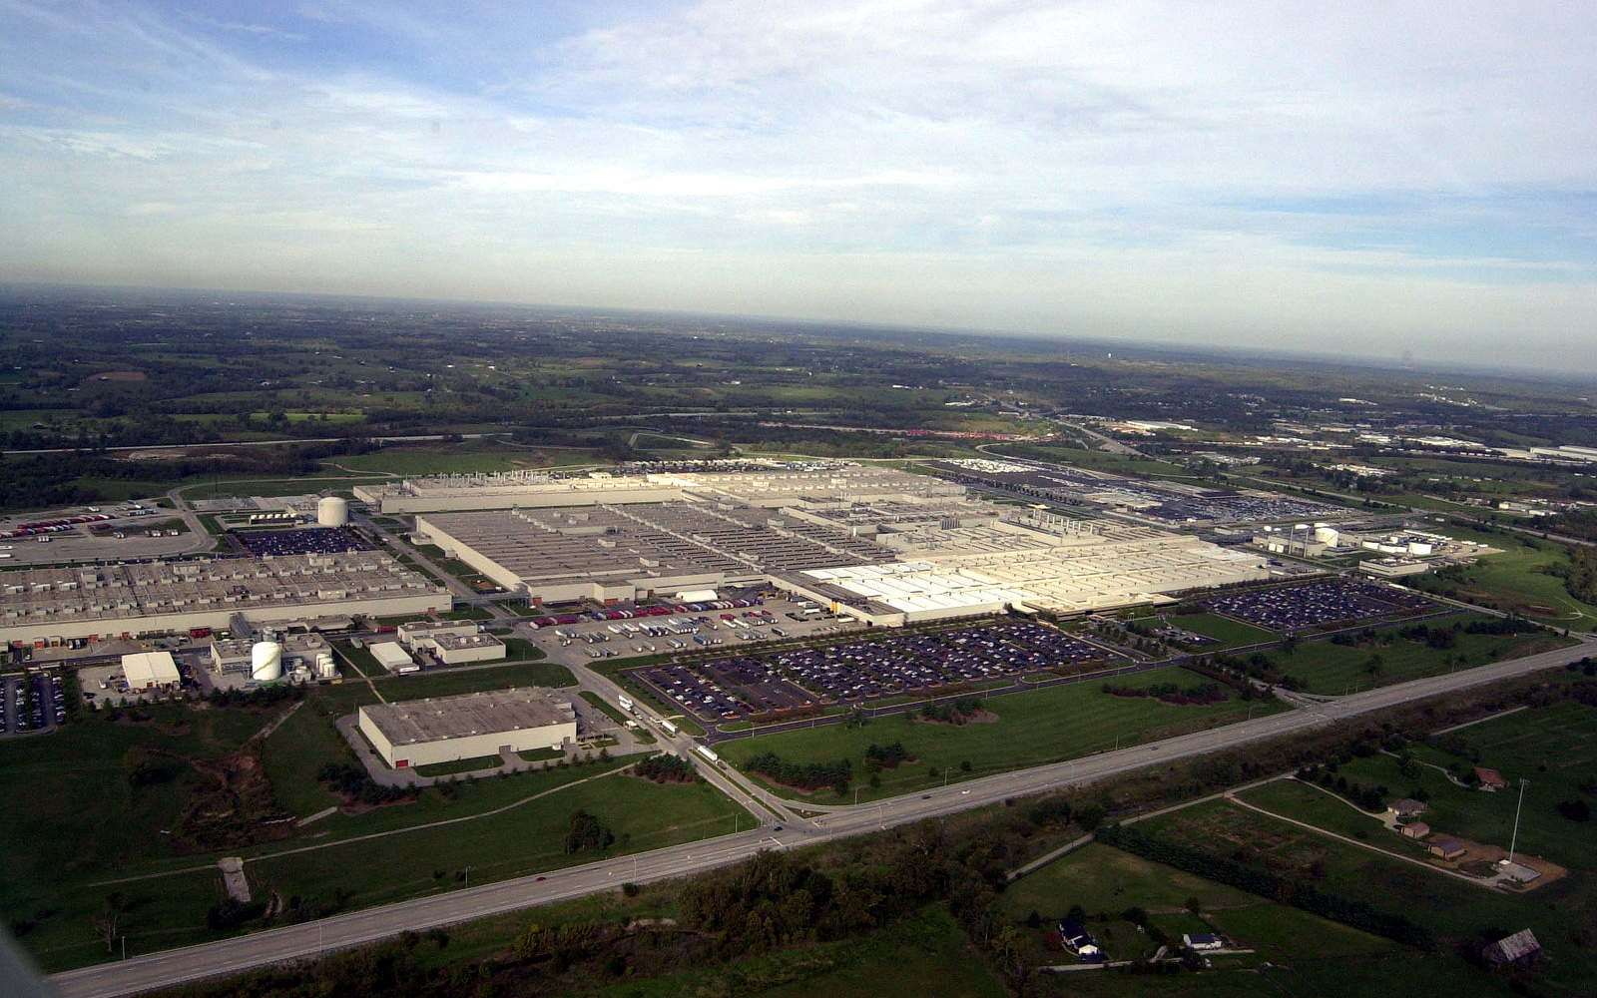
Toyota Manufacturing Plant
Service: industrial production of Toyota vehicles
Emits 68,437MT of Carbon Dioxide annually

Slide 10
Climate Action Plan
Illinois

Slide 11
Overview
Illinois’ Climate Action Plan was presented by the Illinois Climate Change Advisory Group and approved by the Governor in 2007
Policy recommendations split into sub-groups:
Transportation, Power/Energy, Cap and Trade, and Commercial, Industrial and Agriculture (CIA)

Slide 12
Transportation
GHG emissions for automobiles (meet CA standards)
Incentives for fuel efficient vehicles
Low-carbon fuels standard (based on CA proposal
Smart Growth initiatives, expansion of mass transit
Fuel Efficiency for all Government vehicles
Passenger and freight rail upgrades

Slide 13
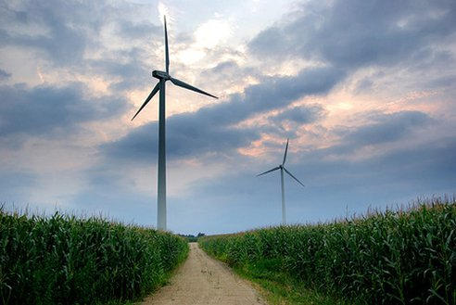
Electric
CO2 emission standards
Small renewable distributed generation: more rules, legislation and incentives
Energy efficiency standards for appliances
Light-bulb energy standards
Energy efficient construction standards
Energy conservation and efficiency programs in state facilities
25% renewables by 2025
2% Energy Demand reduction by 2015

Slide 14
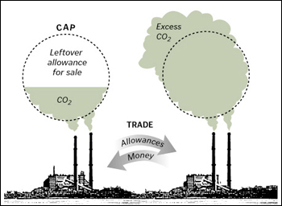
Cap and Trade
20% Carbon Offset requirements for new Fossil Fuel generation
Cap-and-trade program for power generators and large industrial sources

Slide 15
CIA
Encourage forest management and re-forestation
Require reductions in other GHGs: N2O, HFCs, PFCs, SF6
Energy efficiency incentives and standards for generators
Expand no-till farming
Encourage Methane capture
Increase traditional recycling diversion rate—stimulate demand for recycled materials
Land-use development off-sets

