Slide 1
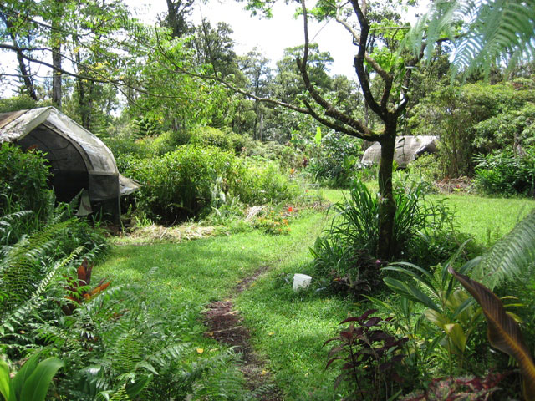
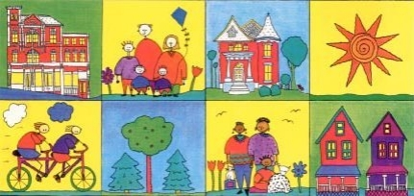
OM Valley Permaculture
Evolving Humanity Through Natural Design

Slide 2
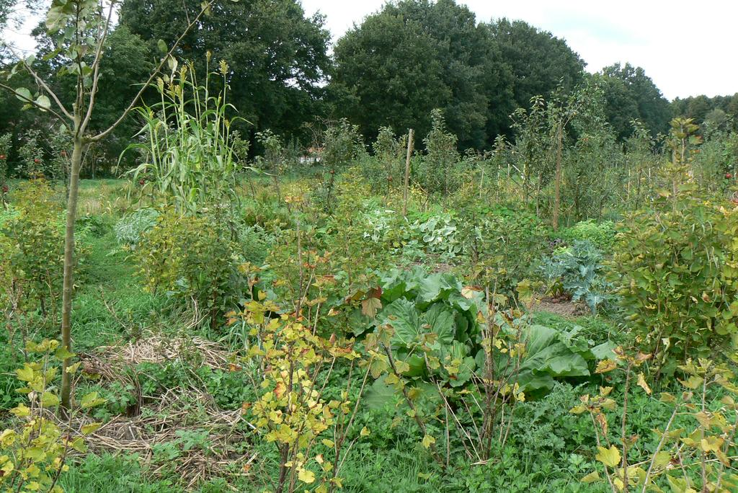
What Is Permaculture?
Branch of ecological design and ecological engineering
Sustainable human settlements and self-maintained agricultural systems
Modeled off natural ecosystems
“philosophy of working with rather than against nature; of protracted and thoughtful observation rather than premature and thoughtless labor; and of looking at plants and animals in all their functions rather than treating any area as a single project system” - Mollison

Slide 3
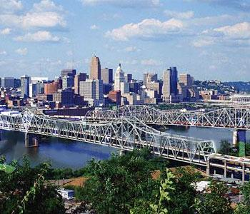
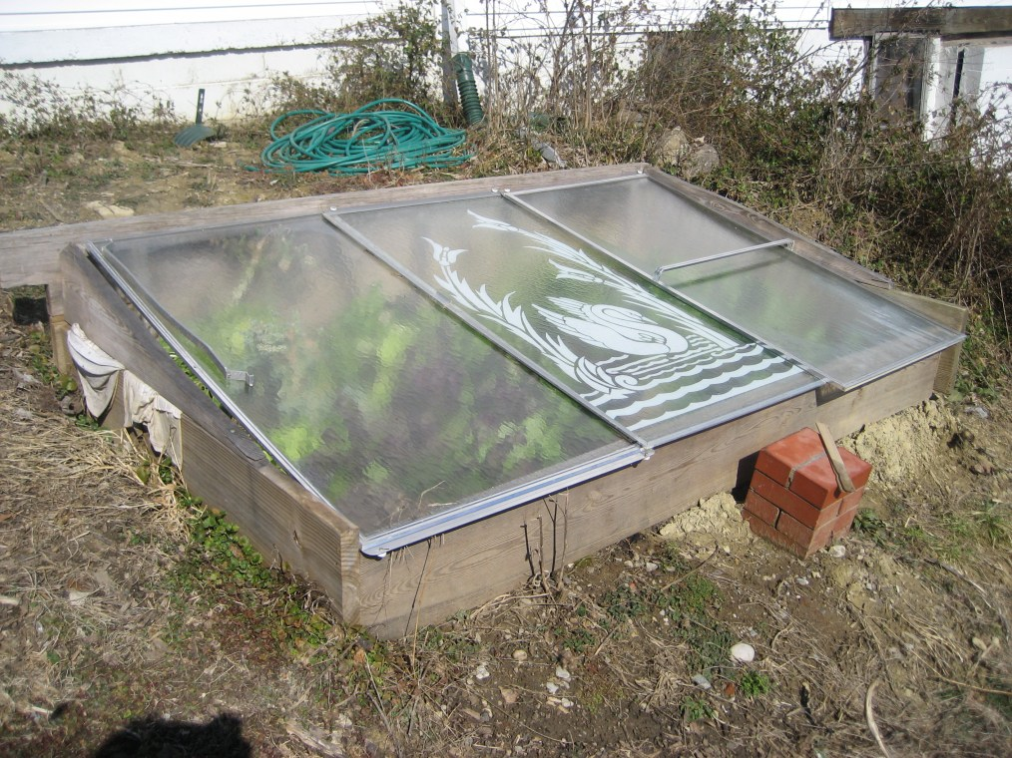
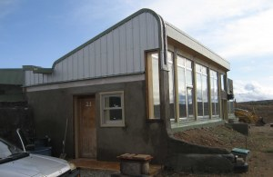
In Cincinnati…
OM Valley Permaculture
Holds meetings, lectures and workshops aimed at educating locals on the principles and practical aspects of permaculture gardening
Works with local non-profit This-Land on promoting sustainable and off-grid building projects
Runs a permaculture nursery—vegetables are sold weekly at the Northside Farmer’s Market

Slide 4
Upcoming OM Valley Events!
Every Wednesday at Northside Farmers Market Vending Edible Perennials
May 4th: Ted Elasser speaking about building Off-Grid Passive Solar Homes (Earthships)
May 4th-13th: Sustainable Building Workshop
July 16th-29th: Permaculture Design Certification Program
Intern Opportunities
Bi-weekly Discussion based meetings: “Spiritual and ethical conversations on creating a perma-culture from the root to the Fruit”
More info at: www.omvalleypermaculture.com

